Slide 1
Monday

Slide 2
Course Logistics
Problem Set 5 – Due Friday, April 14
Project Milestone 3 – Due Wednesday!

Slide 3
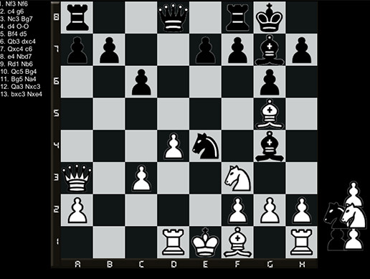
Defining Our Problem Space
Agent – A decision-making entity
Environment – The space in which the Agent is making decisions
State (S) – The current status of the Environment
Goal – An eventual outcome sought by the Agent
Reward (R) – Intermediate measure of success/failure towards the Goal
Action (A) – The options available to the Agent to change the State

Slide 4
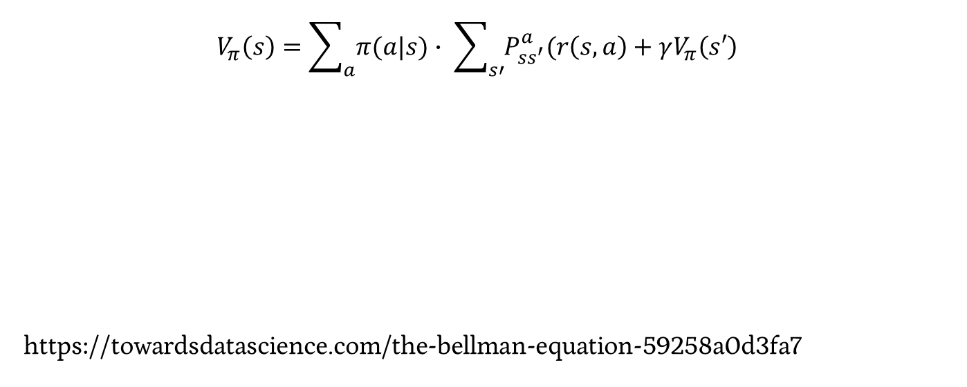

Bellman Equations: Value
$$V_{π}\left(s\right)=\sum_{a}{π(a|s)}∙ \sum_{s′}{P_{ss^{′}}^{a}(r\left(s,a\right)+γV_{π}\left(s′\right)}$$
https://towardsdatascience.com/the-bellman-equation-59258a0d3fa7

Slide 5
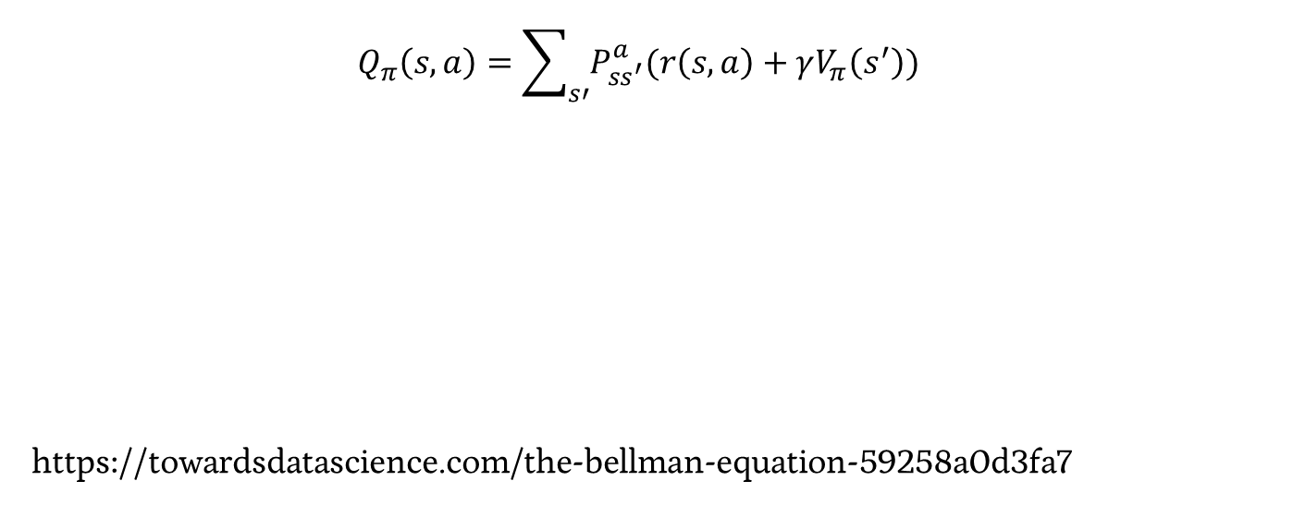
Bellman Equations: Q
$$Q_{π}\left(s,a\right)=\sum_{s′}{P_{ss^{′}}^{a}(r\left(s,a\right)+γV_{π}\left(s^{′}\right))}$$
https://towardsdatascience.com/the-bellman-equation-59258a0d3fa7

Slide 6
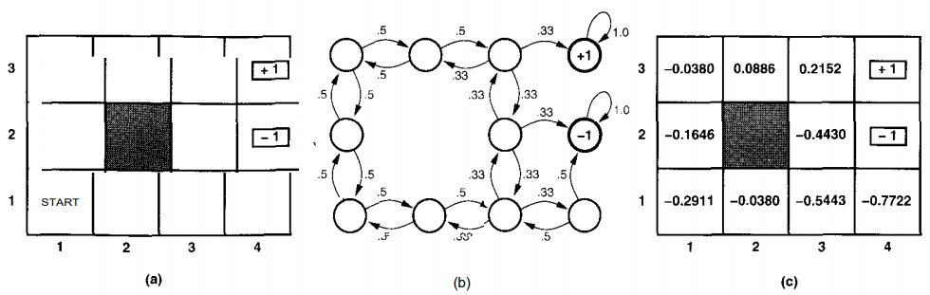
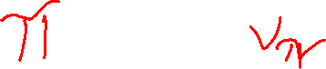
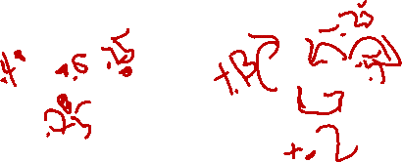
Developing Q – Updating Policy
You can use this approach to feed back into your decision policies!
Notes:
https://www.cin.ufpe.br/~tfl2/artificial-intelligence-modern-approach.9780131038059.25368.pdf

Slide 7
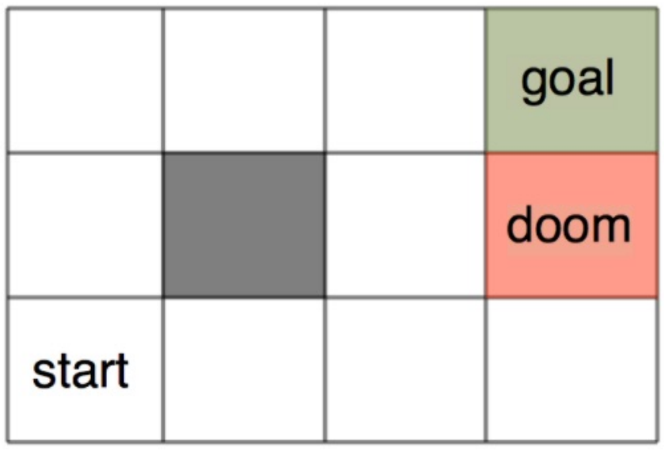
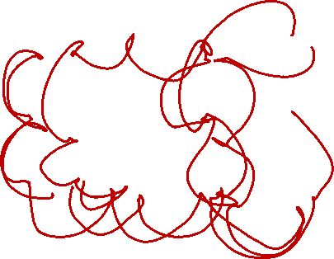
Developing Q – Monte Carlo

Slide 8
Problems to Address
Dealing with the problem of scale
Choosing our “features” to represent state
- easy in games, hard in the real world
Generalization

Slide 9
Problem Space Representation - Features

Slide 10
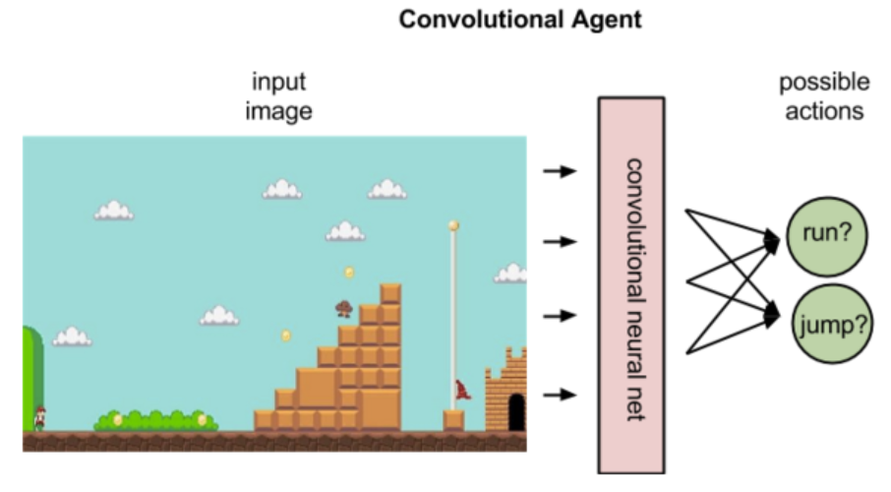

Problem Space – Video Games
Notes:
https://skymind.ai/wiki/deep-reinforcement-learning

Slide 11
Problems to Address
Dealing with the problem of scale
Choosing our “features” to represent state
- easy in games, hard in the real world
Generalization

Slide 12
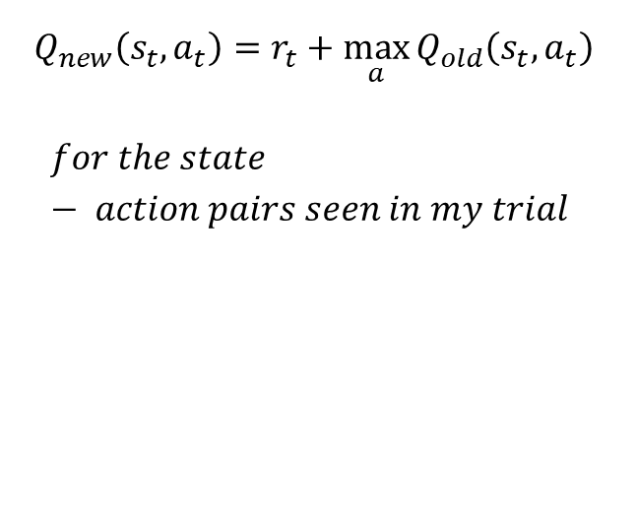
Q – Monte Carlo
$$Q_{new}\left(s_{t},a_{t}\right)=r_{t}+\max_{a}{Q_{old}\left(s_{t},a_{t}\right)}$$
$$for the state − action pairs seen in my trial$$

Slide 13
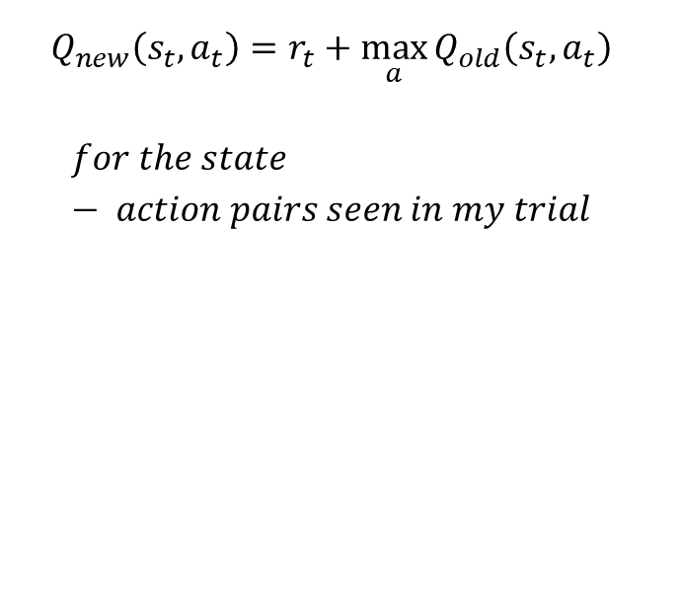
Q – Generalizing?
$$Q_{new}\left(s_{t},a_{t}\right)=r_{t}+\max_{a}{Q_{old}\left(s_{t},a_{t}\right)}$$
$$for the state − action pairs seen in my trial$$

Slide 14
Generalization
How have we avoided problems with missing samples in the past?

Slide 15
Generalization
How have we avoided problems with missing samples in the past?
Think back to NB!

Slide 16

Overfitting Solutions - Smoothing
Builds on the assumption that “nothing is impossible”
Notes:
https://media.giphy.com/media/cT9tZDsVQL1II/giphy.gif

Slide 17
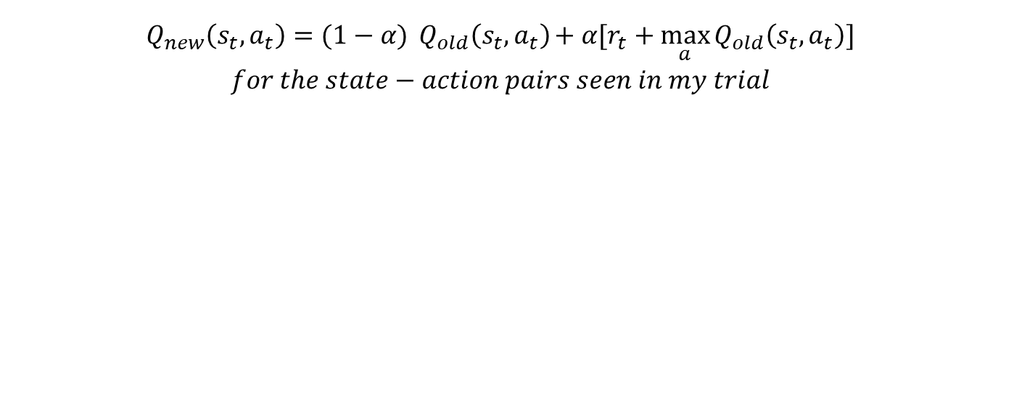
Updating Q
$$Q_{new}\left(s_{t},a_{t}\right)=(1−\text{α}){Q_{old}\left(s_{t},a_{t}\right)}\text{+ }\text{α}[r_{t}+\max_{a}{Q_{old}\left(s_{t},a_{t}\right)}]$$
$$for the state−action pairs seen in my trial$$

Slide 18
Clustering

Slide 19
Supervised vs. Unsupervised Learning
Supervised – ground truth X (features), Y (answer)
- Trying to get a machine to predict Y based on X
- Building / implementing a function to map X to Y
- Trying to capture the hidden structure

Slide 20
Supervised vs. Unsupervised Learning
Supervised – ground truth X (features), Y (answer)
- Trying to get a machine to predict Y based on X
- Building / implementing a function to map X to Y
- Trying to capture the hidden structure
Discrete Continuous
Classification Regression
- divide my samples into classes - generate a continuous value

Slide 21
Supervised vs. Unsupervised Learning
Supervised – ground truth X, Y
- Trying to get a machine to predict Y based on X
- Building / implementing a function to map X to Y
- Trying to capture the hidden structure
Unsupervised – ground truth X
- No ground truth Y*
- Building / implementing a function to model hidden structure
*Ground truth may actually exist, we just a) can’t capture it, or b) are choosing to not use it for our task

Slide 22
Clustering
Clustering – ground truth X
- No ground truth Y*
- Trying to develop classes from the bottom up
- Trying to build based on hidden structure
*Ground truth may actually exist, we just a) can’t capture it, or b) are choosing to not use it for our task

Slide 23
Clustering
Clustering – ground truth X
- No ground truth Y*
- Trying to develop classes from the bottom up
- Trying to build based on hidden structure
Finding clusters such that
- Examples within a cluster are similar
- Examples between clusters are dissimilar
*Ground truth may actually exist, we just a) can’t capture it, or b) are choosing to not use it for our task

Slide 24

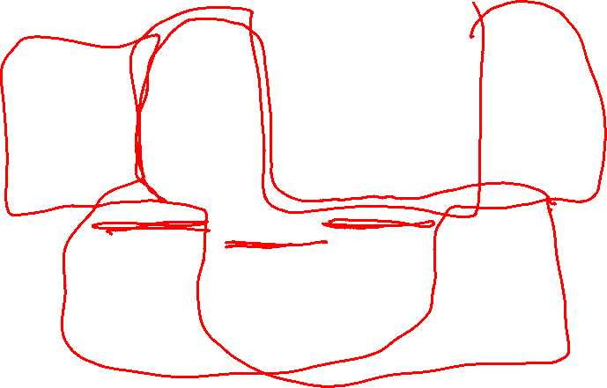
Clustering Examples

Slide 25
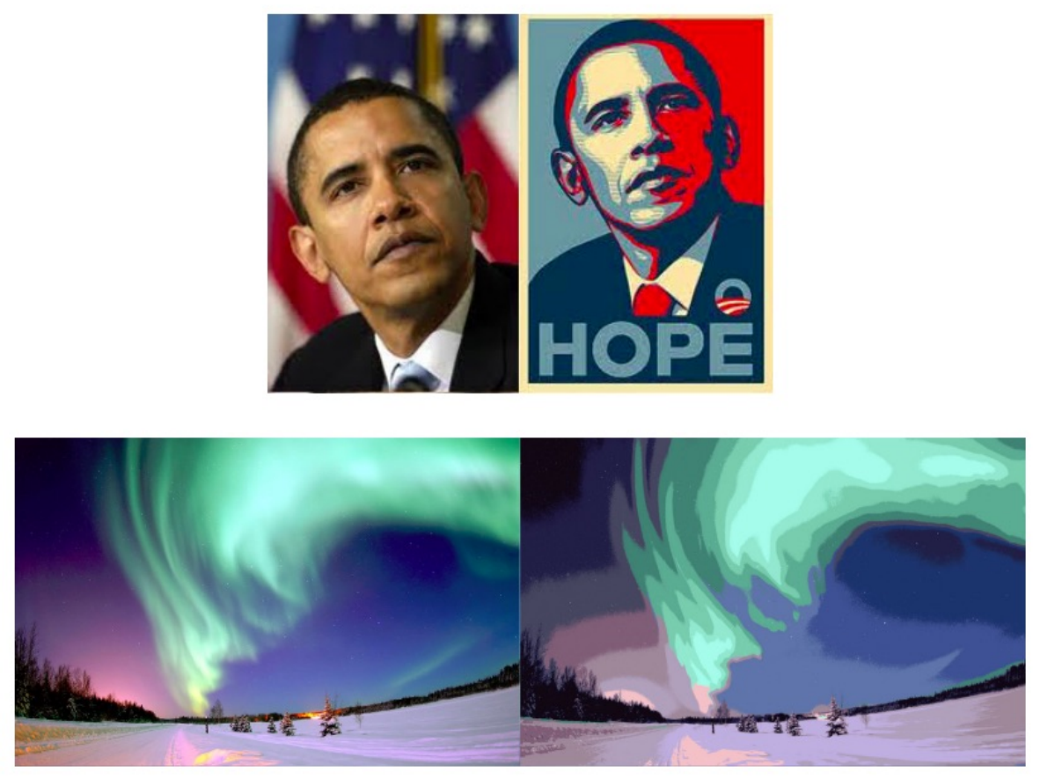
Clustering Examples

Slide 26
Clustering
Clustering – ground truth X
- No ground truth Y*
- Trying to develop classes from the bottom up
- Trying to build based on hidden structure
Finding clusters such that
- Examples within a cluster are similar
- Examples between clusters are dissimilar
*Ground truth may actually exist, we just a) can’t capture it, or b) are choosing to not use it for our task

Slide 27
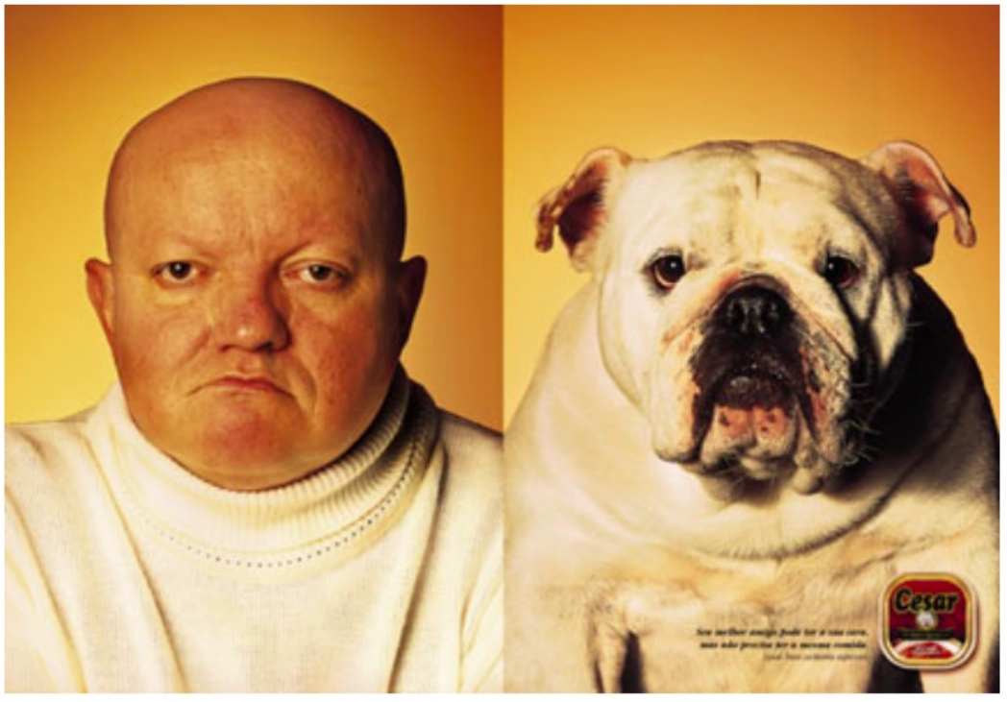
Clustering – Examples of Similarity
Eyeball test

Slide 28
Clustering – Examples of Similarity
Eyeball test
Not something we can calculate

Slide 29
Clustering – Examples of Similarity
Euclidian Distance = ||x – y ||²

Slide 30
Clustering – Examples of Similarity
Euclidian Distance = ||x – y ||²
Edit Distance: Number of character changes (insert, delete, edit) to convert string x to string y

Slide 31
Clustering – Examples of Similarity
Euclidian Distance = ||x – y ||²
Edit Distance: Number of character changes (insert, delete, edit) to convert string x to string y
Sit to Cart
Cit
Cat
Cart

Slide 32
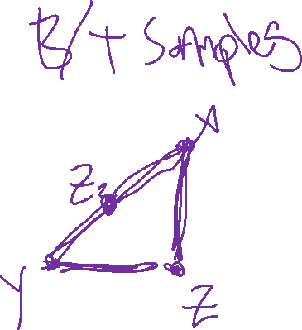
Clustering – Similarity Rules
Given a distance measure d(x,y)
Symmetry: d(x,y) = d(y,x)
Self Consistency: d(x,x) = 0
Positivity: d(x,y) = 0 if x = y
Triangle Inequality: d(x,y) <= d(x,z) + d(z,y)

Slide 33
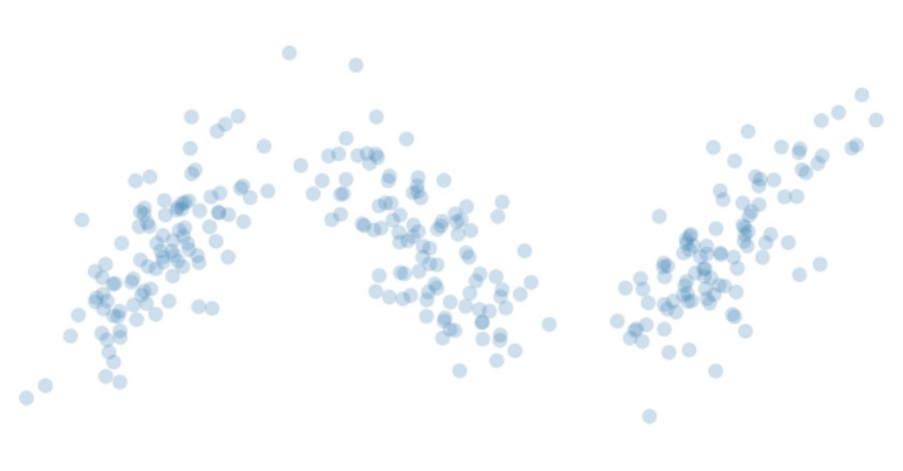
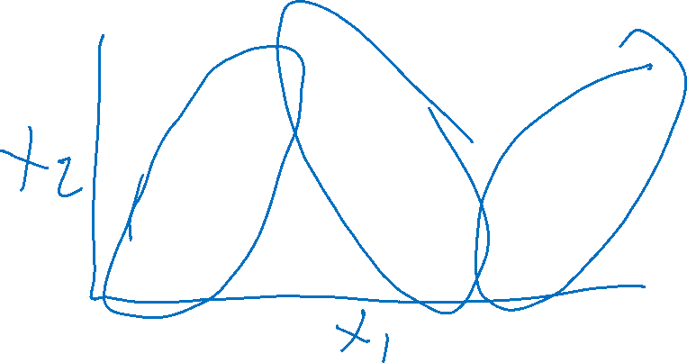
Clustering – K Means
Start with your Data

Slide 34
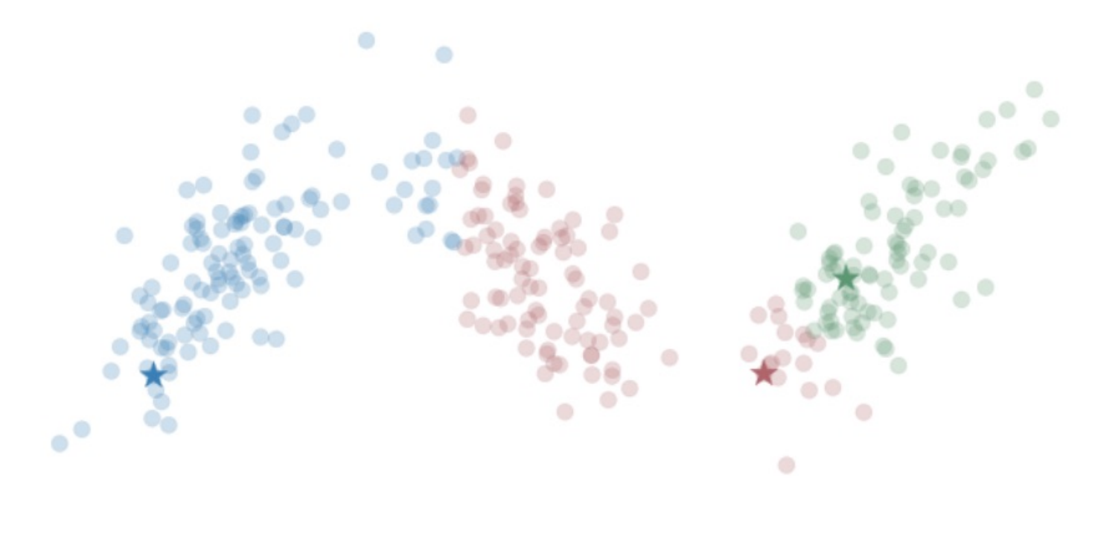
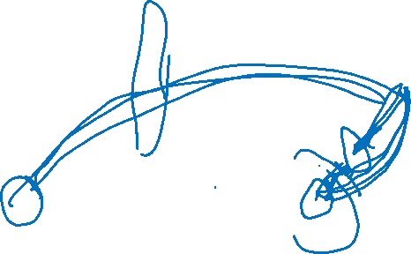
Clustering – K Means
Start with your Data
Choose K centroids
(means)
Assign each point to its
nearest cluster

Slide 35
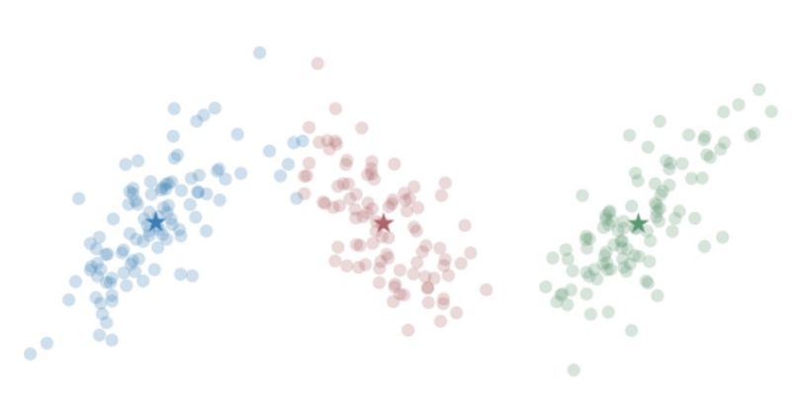
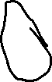
Clustering – K Means
Start with your Data
Choose K centroids
(means)
Assign each point to its
nearest cluster
Re-center your centroids
(means)

Slide 36
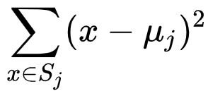
Clustering – K Means
Start with your Data
Choose K centroids
Until we converge:
Reassign points
Re-center
What do we minimize?
Sample to Centroid Distance

Slide 37
Clustering – K Means
Samples = matrix (of features X entries)
Cents = array of K random points (within min, max of each dimension)
While not max_iter, changed_points > 0, Cents – Old_cents > lamda:
Sample_cluster = array tracking nearest centroid (aka cluster)
Cents ← recompute based on Sample_cluster (keep old to loop)
Return sample_cluster, Cents

Slide 38
K Means
What’s going to happen in a variety of edge cases?

Slide 39
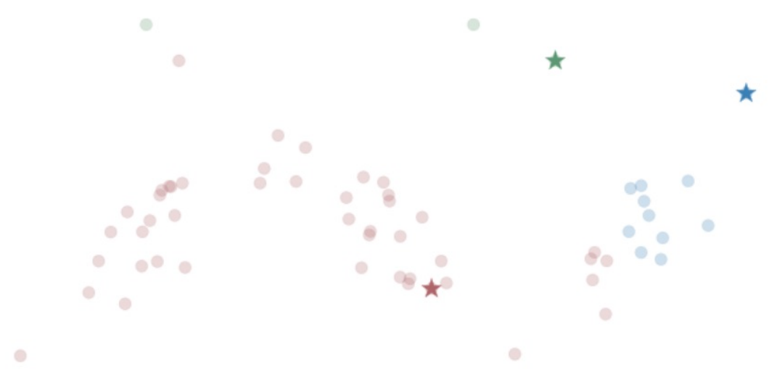
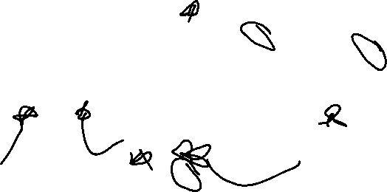
K Means - Outliers

Slide 40
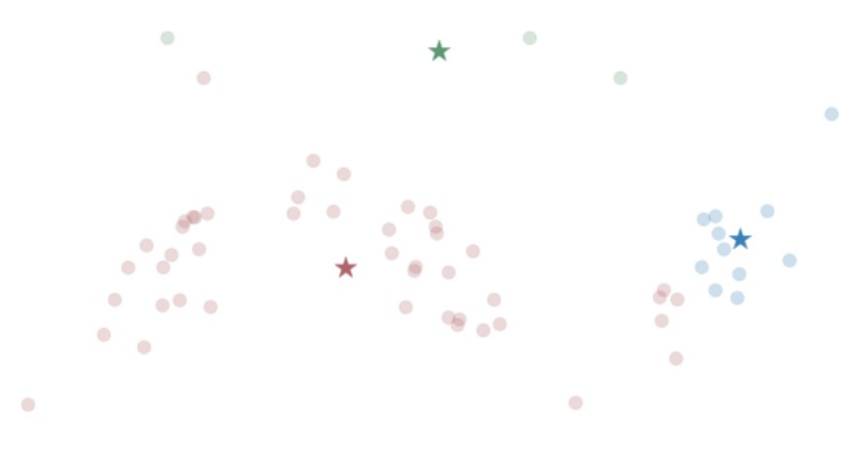
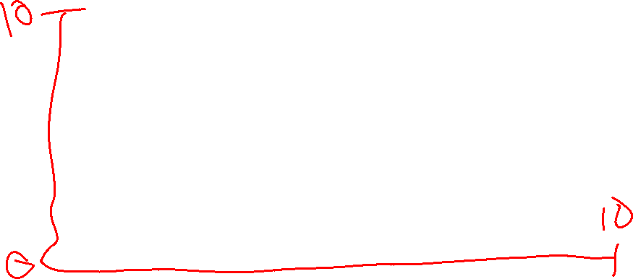
K Means – Outliers

Slide 41
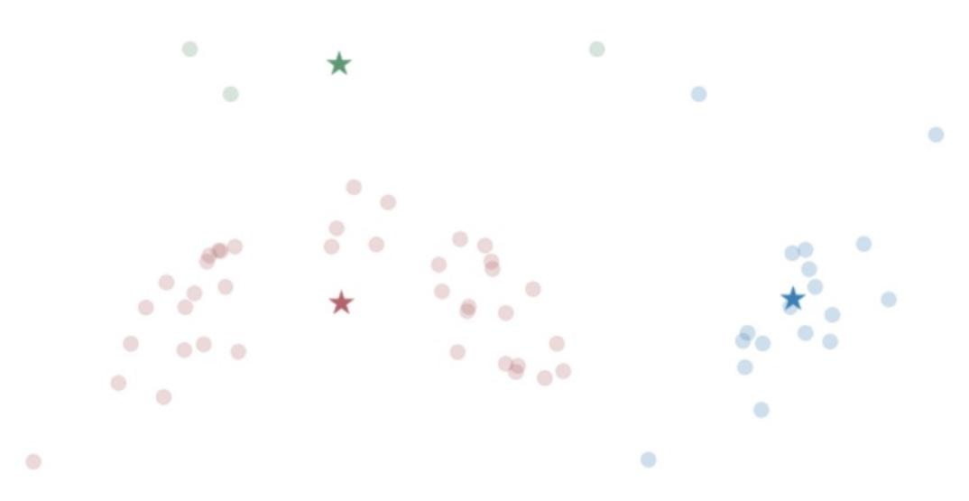
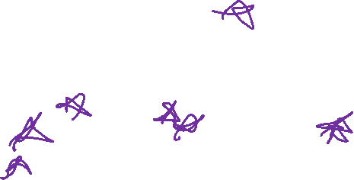
K Means – Outliers

Slide 42
K Means – Sensitive to Initial Centroids
K Means can be easily thrown off by outliers or nonlinearities
Can converge to a variety of points
- Converging to Local Minimum
Fix?

Slide 43
K Means – Sensitive to Initial Centroids
K Means can be easily thrown off by outliers or nonlinearities
Can converge to a variety of points
- Converging to Local Minimum
Fix?
Run several times (random initialization) and choose best

Slide 44
K Means – Sensitive to Initial Centroids
K Means can be easily thrown off by outliers or nonlinearities
Can converge to a variety of points
- Converging to Local Minimum
Fix?
Run several times (random initialization) and choose best
K Means ++:
Initialize a first centroid at random
For each subsequent centroid
Weighted random sample inversely proportional to distance to others

Slide 45
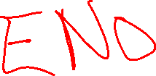
K Means - # Clusters
Expectation with 3 clusters

